Slide 1

Graph Analytics Kaustubh Kulkarni
Note to other teachers and users of these slides: We would be delighted if you found this our material useful in giving your own lectures. Feel free to use these slides verbatim, or to modify them to fit your own needs. If you make use of a significant portion of these slides in your own lecture, please include this message, or a link to our web site: http://www.mmds.org
Adopted from: Mining of Massive Datasets
Jure Leskovec, Anand Rajaraman, Jeff Ullman Stanford University
http://www.mmds.org

Slide 2
What is a Social Network?
The essential characteristics of a social network are:
There is a collection of entities that participate in the network.
There is at least one relationship between entities of the network
There is an assumption of non-randomness or locality.

Slide 3
Social Graphs
Social networks are naturally modeled as graphs, which we sometimes refer to as a social graph.
The entities are the nodes, and an edge connects two nodes if the nodes are related by the relationship that characterizes the network.
If there is a degree associated with the relationship, this degree is represented by labeling the edges.
Often, social graphs are undirected, as for the Facebook friends graph.
But they can be directed graphs, as for example the graphs of followers on X or Instagram.

Slide 4
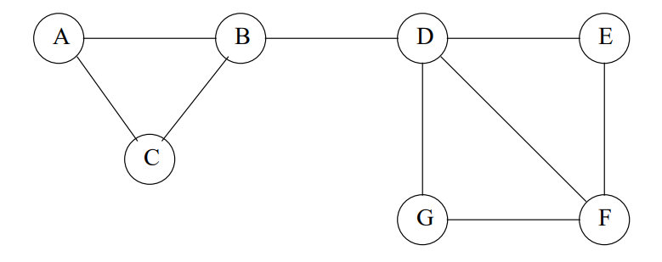
Example of a social graph

Slide 5
Figure in the previous slide is an example of a tiny social network.
The entities are the nodes A through G.
B is friends with A, C, and D.
Is this graph really typical of a social network, in the sense that it exhibits locality of relationships?

Slide 6
First, note that the graph has nine edges out of the 7C2= 21 pairs of nodes that could have had an edge between them.
Suppose X, Y , and Z are nodes, with edges between X and Y and also between X and Z.
What would we expect the probability of an edge between Y and Z to be?

Slide 7
Since we already know there are edges (X, Y ) and (X, Z), there are only seven edges remaining.
Those seven edges could run between any of the 19 remaining pairs of nodes.
Thus, the probability of an edge (Y, Z) is 7/19 = .368

Slide 8
Now, we must compute the probability that the edge (Y, Z) exists given that edges (X, Y ) and (X, Z) exist.
What we shall count is pairs of nodes that could be Y and Z, without worrying about which node is Y and which is Z

Slide 9
If X is A, then Y and Z must be B and C, in some order.
Since the edge (B, C) exists, X=A contributes one positive example (where the edge does exist) and no negative examples (where the edge is absent).

Slide 10
The cases where X is C, E, or G are essentially the same.
In each case, X has only two neighbors, and the edge between the neighbors exists.
Thus, we have seen four positive examples and zero negative examples so far.

Slide 11
Now, consider X = F.
F has three neighbors, D, E, and G.
There are edges between two of the three pairs of neighbors, but no edge between G and E.
Thus, we see two more positive examples and we see our first negative example.

Slide 12
If X = B, there are again three neighbors, A,C,D.
But only one pair of neighbors, A and C, has an edge.
Thus, we have two more negative examples, and one positive example.

Slide 13
Finally, when X = D, there are four neighbors.
Of the six pairs of neighbors, only two have edges between them.
Negative += 4, Positive += 2

Slide 14
Thus, the total number of positive examples is nine and the total number of negative examples is seven.
Positive / (Negative+ Positive) =9/16=0.563
This fraction is considerably greater than the .368 expected value
We conclude that our network does indeed exhibit the locality expected in a social network.

Slide 15
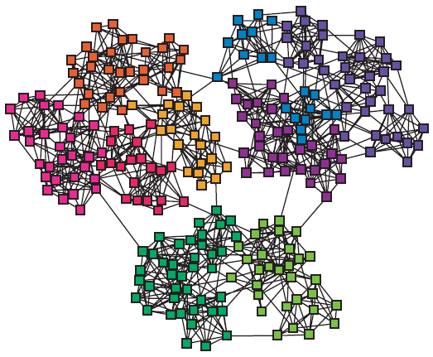
Networks & Communities
We often think of networks being organized into modules, cluster, communities:

Slide 16
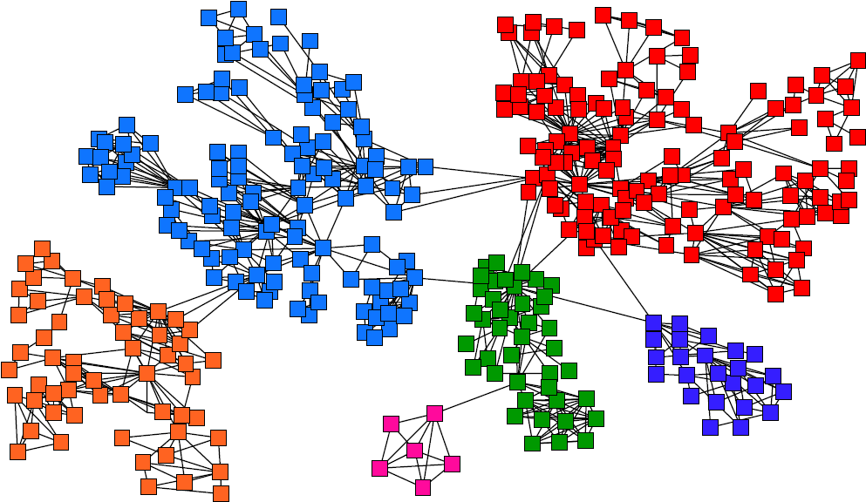
Goal: Find Densely Linked Clusters

Slide 17
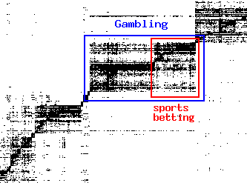
Micro-Markets in Sponsored Search
Find micro-markets by partitioning the query-to-advertiser graph:
query
advertiser
[Andersen, Lang: Communities from seed sets, 2006]

Slide 18
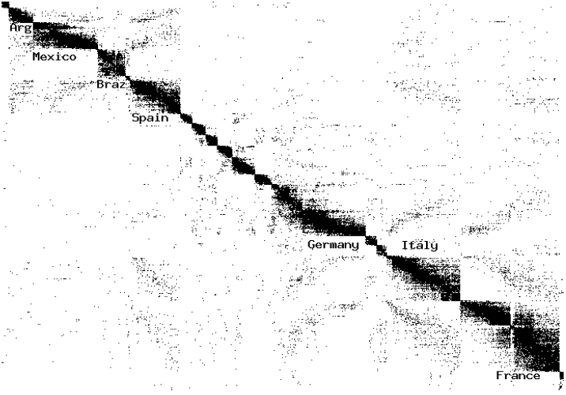
Movies and Actors
Clusters in Movies-to-Actors graph:
[Andersen, Lang: Communities from seed sets, 2006]

Slide 19
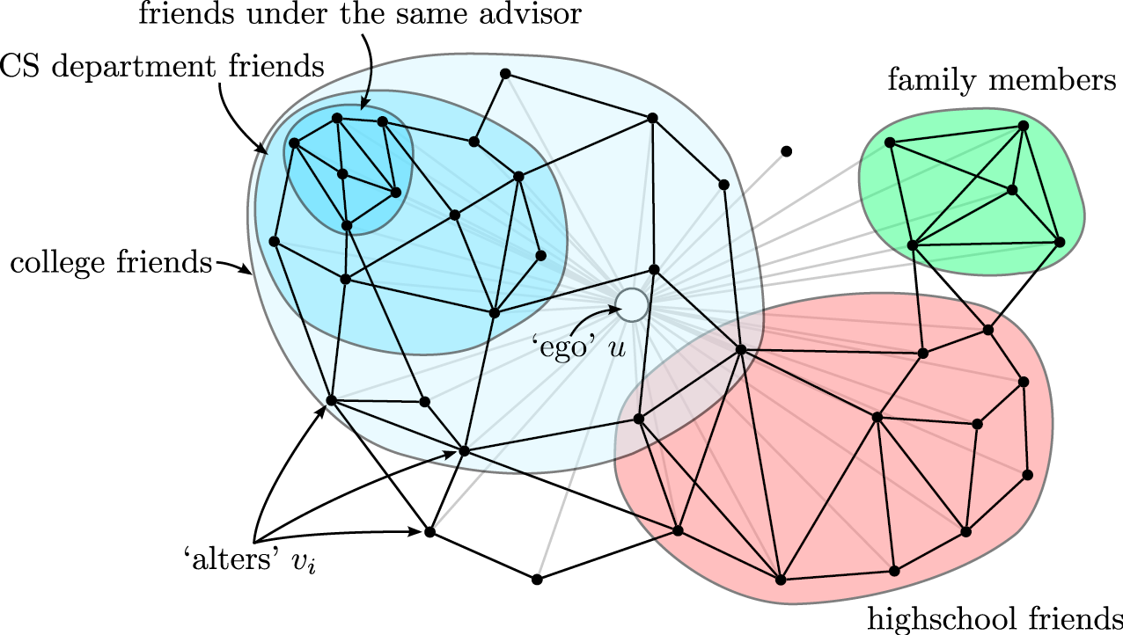
Twitter & Facebook
Discovering social circles, circles of trust:
[McAuley, Leskovec: Discovering social circles in ego networks, 2012]

Slide 20
Questions?

